Slide 1

CREDIT CARD USER ATTRITION ANALYSIS
MIS 561
Group 9

Slide 2





ANALYST TEAM MEMBERS
Bavya
Nalajala
Ananthakrishnan
Mohan Menon
Koumudi
Vellanki
Bhavana
Sarvesh

Slide 3
AGENDA
PG.NO | TOPIC | PRESENTER
4 | Problem Statement and Objectives | Bavya Nalajala
5 | Dataset | Bavya Nalajala
6 | Exploratory Dashboard | Ananthakrishnan Mohan Menon
7 – 10 | Explanatory Dashboards | Koumudi Vellanki & Ananthakrishnan
11 | Data Limitations | Bhavana Sarvesh
12 | Future Scope | Bhavana Sarvesh
13 | Conclusion | Bhavana Sarvesh

Slide 4

PROBLEM STATEMENT & OBJECTIVE
Bank of America is facing a critical challenge of high customer attrition, impacting its revenue and growth. The management team, seeks a comprehensive analysis to understand the factors driving attrition.
We as analysts, will provide clean, insightful data, interactive dashboards, and actionable visuals to enable exploration and strategic decision-making, enhancing customer retention and optimizing operational efficiency.
  Project Deliverables
Cleaned Excel File
Exploratory and Explanatory Dashboards
Insights

Slide 5
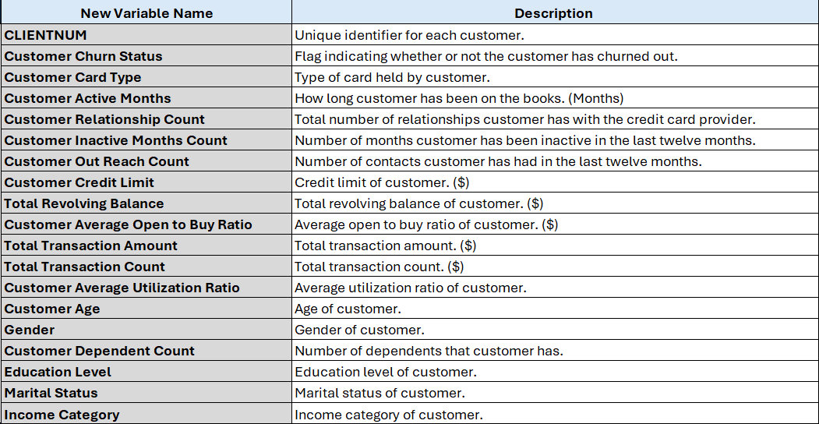
DATASET
The dataset captures customer demographics such as Age, Gender, Education, Marital Status, Income along with engagement metrics like Active Months, Outreach Count, and financial data (Credit Limit, Utilization, Transactions).
Data Cleaning Process:
Approximately 10% of the data had missing demographic information (marital status, education, income category), marked as "unknown."
Given the volume, we opted not to impute these values to maintain data integrity.
Standardized variable names and prepared pivot tables for quick insights into attrited vs. existing customers.

Slide 6
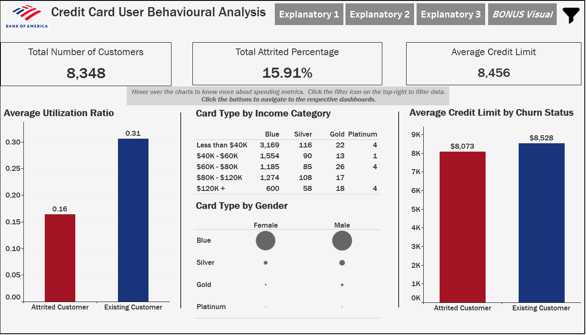
EXPLORATORY DASHBOARD
This exploratory dashboard offers interactive visuals to analyze customer metrics and filter by gender, education and marital status, helping executives uncover numeric trends driving attrition.
We can directly derive that retaining existing high-utilization customers and targeting higher-income segments are helpful for growth

Slide 7
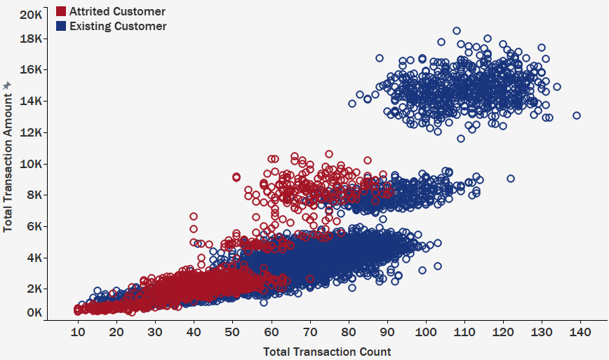

TRANSACTION VOLUME BY CUSTOMER RETENTION PATTERN
This scatter plot helps identify critical customer segments and churn risk patterns, making it valuable for developing targeted retention strategies and understanding customer behavior across different transaction levels.
It is suggested to focus on retaining mid-tier customers (50-80 transactions) through targeted programs, while also analyzing and applying successful retention strategies from high-value customers.
Future scope mentioned in the later slides

Slide 8
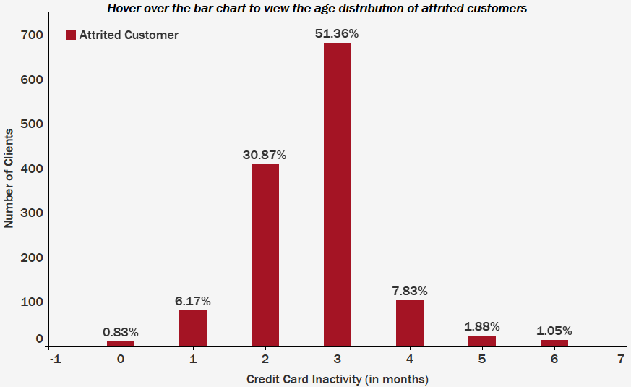
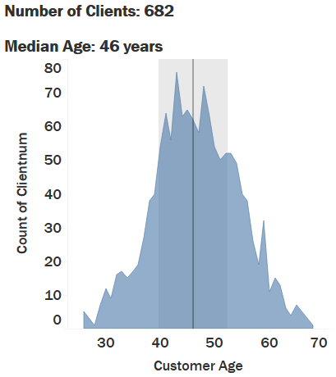
ATTRITED CUSTOMER BY CREDIT CARD INACTIVITY
This bar graph helps identify critical inactivity periods leading to attrition. The hover feature adds depth by revealing age-based customer distributions, enabling you to target specific demographics for re-engagement strategies.

Slide 9
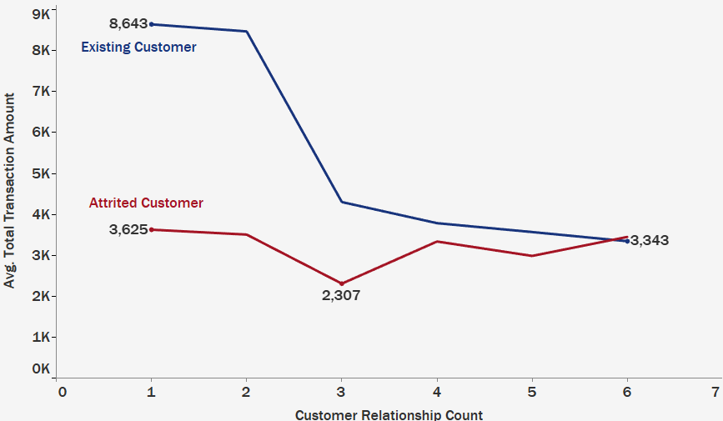
CUSTOMER EXPENDITURE BY CUSTOMER RELATIONSHIP COUNT
This line graph helps you quickly identify high-value segments and develop targeted retention strategies for optimal engagement. We can see that spending declines as customers hold more relationships.
Customers with fewer relationships show higher transaction amounts, suggesting that multiple products may dilute focus. Retention efforts should target high-value customers with 1-2 relationships by offering loyalty rewards to enhance spending.

Slide 10
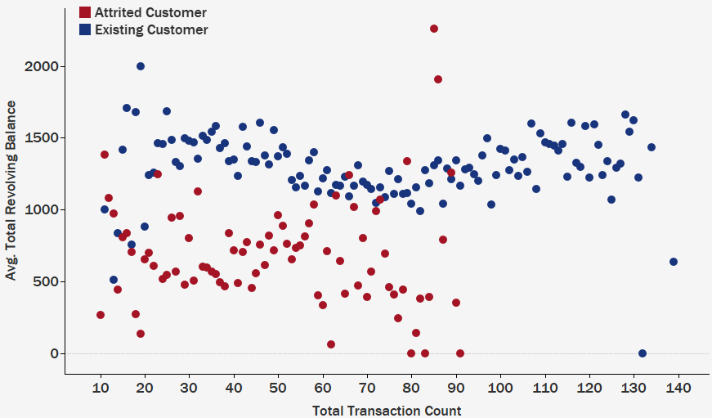
TRANSACTION COUNT BY AVERAGE REVOLVING BALANCE
This scatterplot highlights the heterogeneity within the customer base and the need to analyze different customer segments.
Data points are scattered and complex hence, further analysis is needed to understand customer behavior.
Offering premium cards to high-balance, low-transaction customers and educating low-balance, high-transaction customers on card benefits could enhance retention.
Future scope mentioned in the later slides

Slide 11
DATA LIMITATIONS
In the “Total Amount Change (Q4-Q1)” and "Total Count Change (Q4-Q1)" variables, it is unclear whether "Total Amount" refers to the total revenue, total spending, total credit limit, or some other financial metric.
No data on competitors' influence or market trends affecting customer decisions.
01
02
Lack of geographic segmentation prevents analysis of region-specific attrition patterns.
The dataset doesn't account for qualitative customer feedback, which may provide deeper insights into dissatisfaction reasons.
03
04

Slide 12





FUTURE SCOPE
Analyze top-tier customers to identify loyalty drivers, like rewards, and apply these insights to improve retention in other segments.
Explore the relationship between digital engagement metrics (e.g., app usage) and customer retention.
Develop predictive models incorporating time-series data to forecast attrition trends in advance.
Expand segmentation analysis to analyze spending and payment behaviors to better understand scattered datapoints.

Slide 13



THANK YOU
Thank you for the opportunity to present our findings on customer attrition. We hope the insights and dashboards provided will support strategic decision-making at Bank of America.
For Follow-Up Inquiries, feel free to contact our Business Analyst team:
  Email: dataops@datainsightsfirm.com
Phone: +14256373906
Here is the LINK to the detailed working dashboards on tableau.

